Slide 1
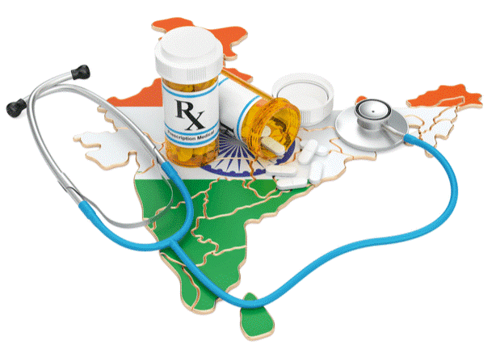
Medical Help in Mumbai
Coursera Capstone Project
Battle of the Neighborhoods
Marina Kate Stephens

Slide 2
Introduction
*Around five million people die every year due to inadequate healthcare - almost a third of them in India!
*Your organization has raised significant funds to open a free health clinic in Mumbai, the 7th largest city in the world, to help reduce deaths that could be avoided with proper healthcare.
*Mumbai is a huge city, but you currently only have funding to open one free clinic. Which area of Mumbai most needs this assistance?

Slide 3
Data
To answer this question, I will use the data from two different sources:
1) The first is geolocation data website Foursquare, which will allow me to see where all the clinics and hospitals are located in Mumbai.
2) The second is 99 Acres, an Indian real estate database website. I will look at property values across the neighborhoods of Mumbai, and then I will assume that average property value and average income are directly related.

Slide 4
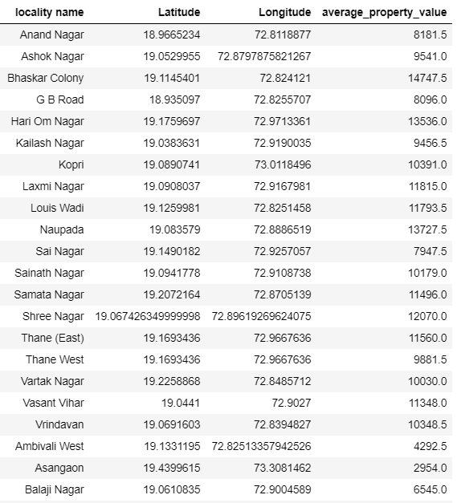
Sample of the data

Slide 5
Methodology
Import libraries and download dependencies.
Import the property value dataset from 99acres and cleanup the dataframe.
Create map of Mumbai to visualize neighborhood location data.
Connect to Foursquare and use their data to find information on location of health care facilities in Mumbai
Find all medical venues within 500m of each neighborhood.
Cluster the neighborhood data based on location, property value, and number of nearby medical venues.

Slide 6
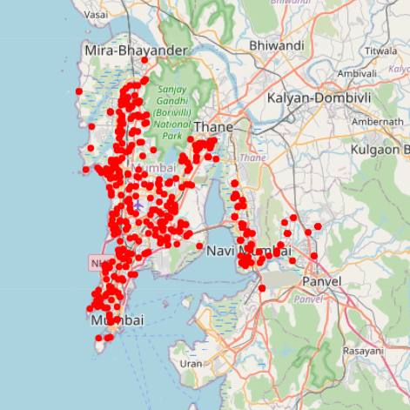
Neighborhoods of Mumbai Using Folium map rendering library to visualize data

Slide 7
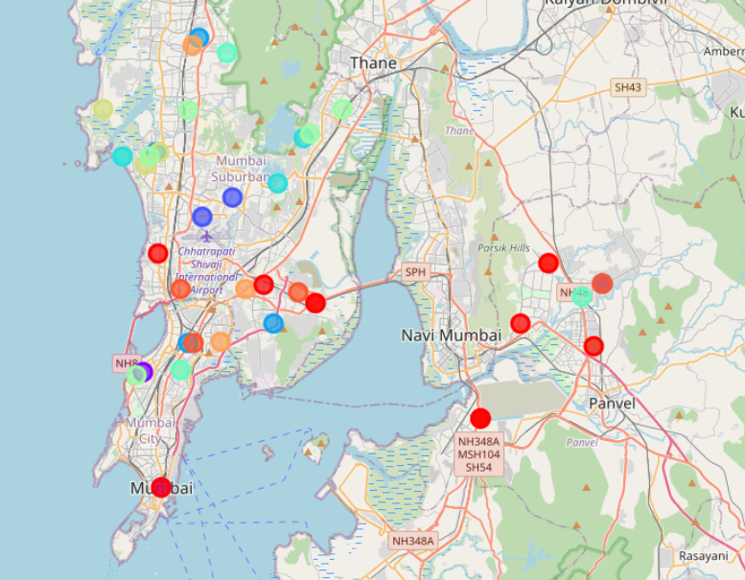
Results 1
Using K-means clustering to divide the 50 poorest neighborhoods into 10 different groups based on latitude, longitude, property value, and number of medical venues

Slide 8
Results 2
This time I used the k-means clustering again but split the data into only 5 different groups

Slide 9
Discussion/Conclusion
Finding the best location to build something in a huge cosmopolitan city like Mumbai is a difficult task. Mumbai is over 230 square miles, has over 500 unique neighborhoods, and has over 24 million citizens. Mumbai has some of the most glamorous neighborhoods and poorest slums in the world. The unique mixture of traditional and modern, rich and poor, local and foreign, makes Mumbai a very unique city with its own unique issues. There is not one single location where those in need are living.
Using the machine learning k-means clustering was only somewhat helpful in determining the best location for our free medical clinic. Visualizing the data on the maps was very useful in understanding where there is a lack of medical care and where the lower income neighborhoods are. The clustering algorithm only returned one group of neighborhoods that were located close together and how low average income. However, the connection was weak. If one is absolutely determined to use machine learning to decide the location for something like a free health clinic, they might need to look at more factors than just income and location. Or, possibly a more complex machine learning algorithm is needed to find the best spot.

Slide 10
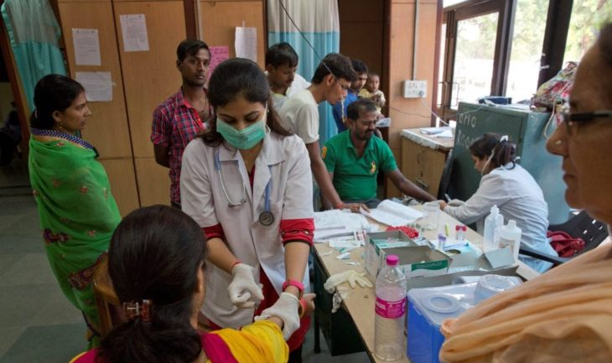
Thank you!!

